Slide 1


Fundamentals of Digital Forensics
Jon PEACOCK
Senior Investigator
Digital Child Exploitation Team
Internal Affairs
NEW ZEALAND

Slide 2
Digital Forensics: Purpose
Attribute, in the real world, the party or parties responsible for online offences
Preserve any evidence in its most original form while performing a structured investigation by collecting, identifying, and validating the digital information to reconstruct past events.
Notes:
Purpose: follow on from DRD presentation about digital evidence and discuss the next step in the process: digital forensics.
Online crime needs attribution to a person in the RL.
Purpose: ensure any evidence obtained is preserved and presented to support the investigation

Slide 3
Digital Forensics: Practice
Best Practice: ACPO: Good Practice for Digital Evidence
Principle 1: No action taken…should change data which may subsequently be relied upon in court.
Principle 2: If data needs to be changed, the person doing so must be competent to do so and be able to give evidence explaining the relevance and the implications of their actions.
Principle 3: An audit trail or other record of all processes applied should be created and preserved. An independent third party should be able to examine those processes and achieve the same result.
Principle 4: The person in charge of the investigation has overall responsibility for ensuring that the law and these principles are adhered to.
Notes:
DF has changed over time:
running the suspect device
sophisticated tools to acquire and present evidence.
Rapidly changing environment: need guiding principles.
ACPO (UK) Good Practice Principles.

Slide 4
Digital Forensics: Preparation
“To Be Prepared is Half the Victory”
Entry to a search ensuring digital forensic considerations have been completed
Tools
Techniques
Chain of Evidence
Personnel
Data storage
Notes:
DF Prep:
Essential to understand the scene you are entering.
Diff between business and residential home
Worst thing to need something on scene and not have it available.
Not only tool sets and software but people skills and capability.

Slide 5
Digital Forensics: Process
Identify
Acquire
Examine
Present
Notes:
4 main considerations of DF phases

Slide 6
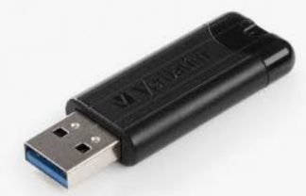


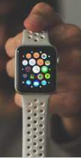
Digital Forensics: Process
Identify
Acquire
Examine
Present
Correctly identify sources of Digital Forensic evidence
Correctly articulate sources of Digital Forensic evidence in legal process
Notes:
IDENTIFY: ties into DRD presentation:
What should be seized, how it should be seized and cover off with legal process to ensure legality.
Legal Process: ensure any application refers to “seize for examination”

Slide 7
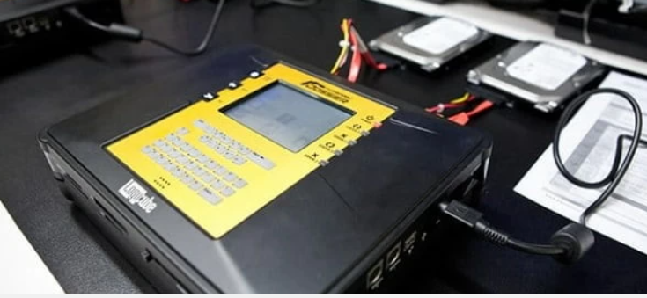
Digital Forensics: Process
Identify
Acquire
Examine
Present
Gather evidential data from a device to ensure:
Identicality
Ability to analyse
Notes:
ACQUIRE: making a verifiable copy of the data on a device for examination
Important phase: this is where we verify the authenticity of the data we refer to.

Slide 8
Digital Forensics: Process
Identify
Acquire
Examine
Present
Review the acquired data to identify evidence of criminal activity
Notes:
EXAMINE: review the acquired copy to identify offending, additional offending, offender and potentially victims.
Range of tools that can be used in this phase. All commercially available tools have ben validated and deemed to be reliable.
Still need the expertise to interpret what the tools are saying

Slide 9
Digital Forensics: Process
Identify
Acquire
Examine
Present
Deliver the findings to the court in a clear and concise way.
Notes:
PRESENT: critically important to present DF findings to prosecutors and ultimately court in a way that clearly communicates the evidence.
Consider live demonstrations

Slide 10
Digital Forensics: Challenges
Officer Capability
Tools Used
Chain of Custody
Legality
Notes:
CHALLENGES: it can be very difficult to challenge evidence identified from a DF process.
Challenges then are aimed at that process

Slide 11
Digital Forensics
Questions?
Notes:
CHALLENGES: it can be very difficult to challenge evidence identified from a DF process.
Challenges then are aimed at that process

