Slide 1

Standard Operating Procedures
Fundamentals of Digital Forensics
Presented by Savenaca Siwatibau
Fiji Police

Slide 2

Presentation Overview
INTRODUCTION
S.O.P
CASE SCENARIO
FINAL ANALYSIS AND REPORTING

Slide 3
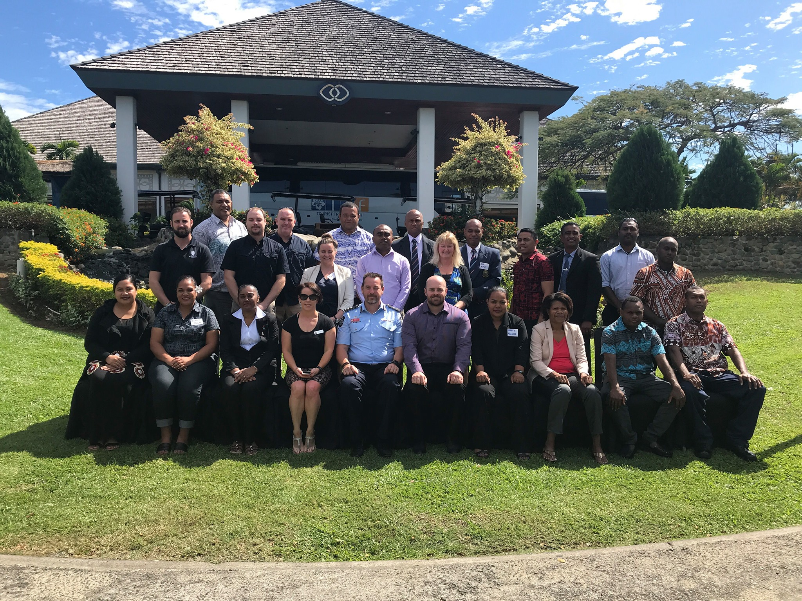
FIJI POLICE FORCE
CYBERCRIME UNIT
ESTABLISHED – 2008
INVESTIGATORS- 6
DIGITAL FORENSICS- 2
Cases- Social Media Cases
Revenge Porn
Cyber Bullying
Self-Harm/Suicide
Cooperate Data Theft
Hacking/ Unauthorized Network Intrusion
Ransomware
BEC – Business Email Compromise

Slide 4
Standard Operating Procedures
What is the SOP. Digital Forensics.
Fiji Police have adopted international best practices in its SOP for Digital Forensics
SOP is still in its finalization stage awaiting the establishment of the Digital Forensics Unit.

Slide 5

CASE SENARIO

Slide 6
Ransomware
Initial report indicates that file sharing sever has been compromised with Ransomware
Company Data is stored
Backup/ Not Reliable
Company Operation is halted
Critical Infrastructure
Minimize Downtime
Notes:
COMPANY NEEDS OF MINIMAL DOWNTIME IS IMPORTANT- even though we are mandated to investigate the network breach but we need to minimize the impact it has on the operation and financial of the company
Discussing and mapping out the response with the Companies Team is also important with the outlying outcome properly explained to the tea

Slide 7
INITIAL ACTIONS
ASSESING – Meeting with the Company IT team to assess and confirm incident
Reporting- Official report to me made
Detail Action- Detail action of Digital Forensics approach.
- Model of Sever
- OS
-Administrative Credentials
-HDD Capacity
-Ransome Noted
-File Extension
-Time and Date of the Incident
Notes:
Proper preparation and understanding of the network is critical. Initial action should include isolating the infected server/machine from the Network. Scanning of the network to identify and other breach or infected machine and also to secure data.
Consultation with any computer security incident response team (CSIRT) or CERT team for technical assistance.

Slide 8
Digital Forensics Technician
Tools Preparation
- Imaging Software
- Evidence HDD
- Sandbox / VMWare
- CERT Team
Notes:
Proper forensics Tools are important for investigation – Audit Trails and Procedual Understanding of the Forensic process are vital to conducting proper Forensic Investigation.

Slide 9
Initial Action.
The Initial Action is the integral part of investigation.
Proper Documentation
Forensics Procedures
Notes:
This are the critical part to be captured in the SOP. A better Understanding and documentation of Forensics Procedures. This will be useful in court and also for debriefing and planing and preparing for the next incident reported.

Slide 10
EXAMINATION AND FINAL ANALYSIS
Appropriate Tools of Examanitaion
Clear Documentation of Examination and Analysis
Proper Report Tabulation
Proper Description of Report Findings
Analysis and Reccomendation
Debriefing with Company IT Team and Digital Forensics Team
Review of process and procedures to prepare for the next incident

Slide 11

VINAKA VAKALEVU/ THANK YOU
QUESTIONS

